Slide 1

3차원 그래프
매트랩 이해 및 실습
최병조
임베디드시스템공학과

Slide 2
강의 주제
Matlab의 역사와 간단한 사용법 | 다항식, 커브 피팅, 인터폴레이션
배열, 행렬 만들기와 소리 다루기 | 3차원 그래프 그리기
행렬과 그림 다루기 | GUIDE로 GUI 만들기
라이브스크립트, 웹 게시, 엑셀 연동 | 애니메이션 GUI
2차원 그래프 그리기 기초 | 앱 디자이너로 GUI 만들기
다양한 2차원 그래프 그리기 | GUI 프로젝트 발표
함수 만들기 | MuPAD로 수학 문제 풀기
중간고사 | 기말고사

Slide 3
You will be able to
Choose the right technique to visualize 3D data,
Plot 3D surface plots with various properties, and
Visualize volume data using iso-surfaces and slices.
All the scripts are available at
https://goo.gl/45vZGJ

Slide 4

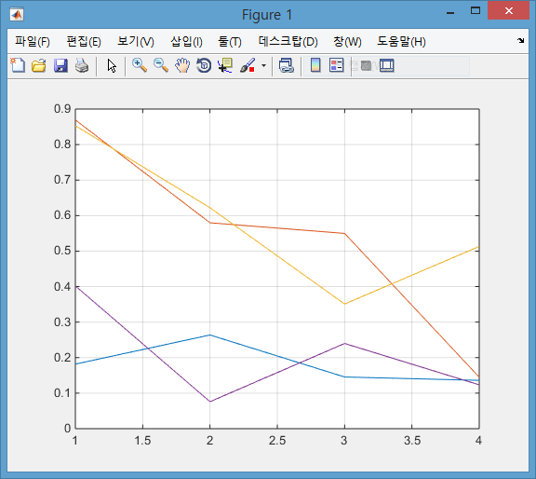
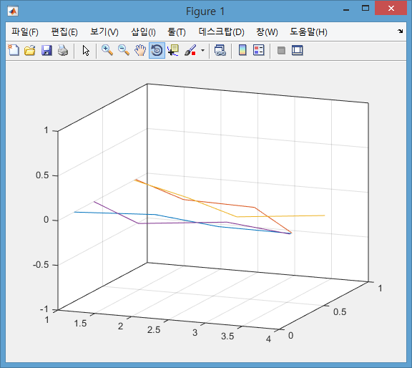
2D Graph on 3D Space
figure(1), plot(rand(4)), grid on;
view(3);

Slide 5
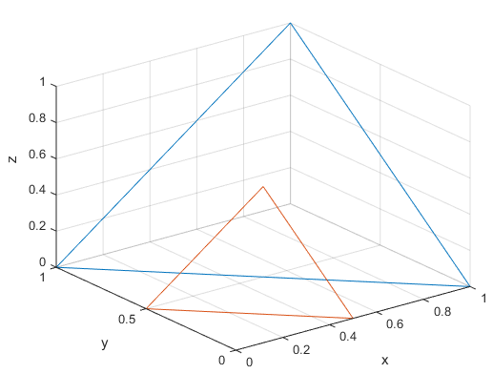
3D Line Plot
plot3( x, y, z )
3
m10_plot3_triangle.m
%% 3차원 공간의 좌표
x = [1 0 1 1]';
y = [0 1 1 0]';
z = [0 0 1 0]';
%% 첫 번째 삼각형
figure(1);
plot3( x, y, z ); grid on;
xlabel('x'); ylabel('y'); zlabel('z');
%% 두번째 삼각형
hold on;
plot3( 0.5*x, 0.5*y, 0.5*z );
hold off;
1
2
3
1
1
2

Slide 6
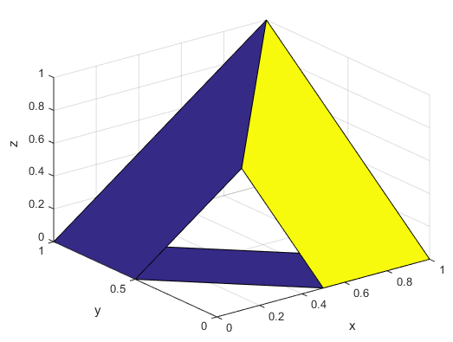
3D Surface Plot
surf( X, Y, Z )
m10_surf_triangle.m
%% 첫 번째 삼각형의 좌표
x1 = [1 0 1 1]';
y1 = [0 1 1 0]';
z1 = [0 0 1 0]';
%% 면의 좌표
X = [x1, 0.5*x1];
Y = [y1, 0.5*y1];
Z = [z1, 0.5*z1];
%% 두 삼각형을 잇는 면
figure(1);
surf( X, Y, Z );
grid on;
xlabel('x'); ylabel('y'); zlabel('z');
2-column matrix

Slide 7
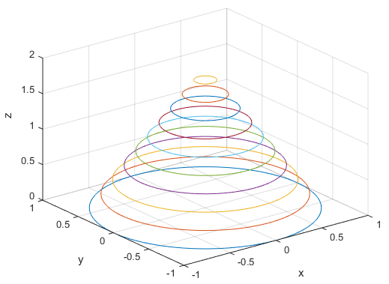
Circles on a Cone
Each column in a Matrix represents each plot.
m10_plot3_cone.m
%% 3차원 공간에서 원의 좌표
t = linspace(0, 2*pi, 100)';
x = cos(t);
y = sin(t);
z = ones(size(x));
r = (1:-0.1:0);
h = 2*(0:0.1:1);
X = x * r;
Y = y * r;
Z = z * h;
%% 3차원 그래프
figure(1);
plot3( X, Y, Z );
grid on;
xlabel('x'); ylabel('y'); zlabel('z');
X
=

Slide 8
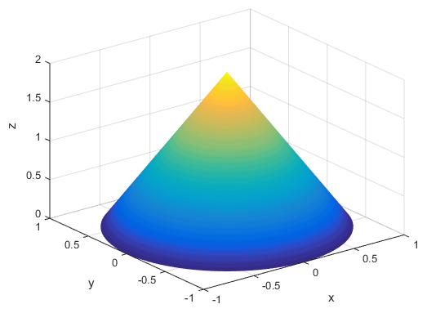
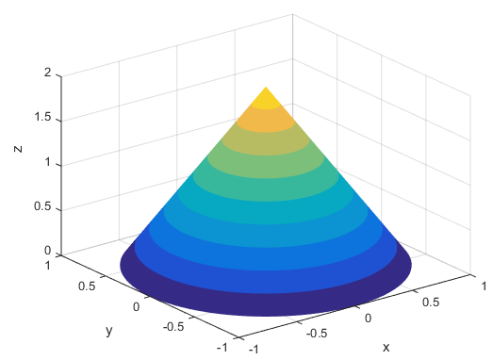
Cone
Each column in a Matrix represents each plot.
m10_surf_cone.m
Color gradation control
%% 3차원 공간에서 원의 좌표
t = linspace(0, 2*pi, 100)';
x = cos(t); y = sin(t);
z = ones(size(x));
r = (1:-0.1:0);
h = 2*(0:0.1:1);
X = x * r;
Y = y * r;
Z = z * h;
%% 3차원 그래프
figure(1);
surf( X, Y, Z, 'LineStyle', 'none');
grid on;
xlabel('x'); ylabel('y'); zlabel('z');
X
=

Slide 9
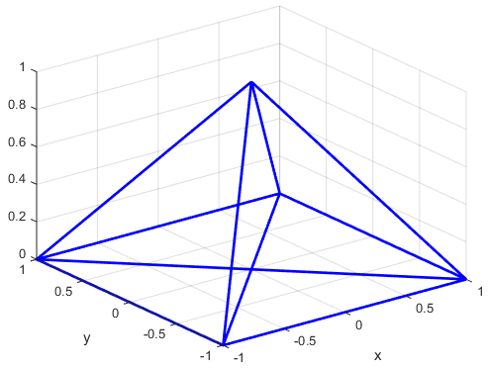
Eulerian Trail: Pyramid
Find an Eulerian trail traversing each edge on the graph below exactly once.
Represent the trail with a set of vectors, x, y, and z.
Use plot3 to draw the graph.
m10_wired_pyramid.m
% Pyramid
x = [ -1 -1 1 1 -1 1 0 1 -1 0 -1 ];
y = [ 1 -1 -1 1 1 -1 0 1 -1 0 1 ];
z = [ 0 0 0 0 0 0 1 0 0 1 0 ];
figure(1);
plot3(x, y, z, 'b-', 'LineWidth', 2);
grid on; xlabel('x'); ylabel('y');

Slide 10
Mesh and Surface Plots
3D plot for z = f ( x, y )
Step 1: Create a grid in the x-y plane.
Step 2: Calculate the values of z .
Step 3: Plot the 3D graph.
5
(-1,4)
(0,4)
(1,4)
(2,4)
(3,4)
X=
4
(-1,3)
(0,3)
(1,3)
(2,3)
(3,3)
3
(-1,2)
(0,2)
(1,2)
(2,2)
(3,2)
2
Y=
(-1,1)
(0,1)
(1,1)
(2,1)
(3,1)
1
-2
-1
0
1
2
3
4

Slide 11
Mesh Grid
Step 1: Create a grid in x-y plane
>> x = -1:3;
>> y = 1:4;
>> [ X Y ] = meshgrid(x,y)
X =
-1 0 1 2 3
-1 0 1 2 3
-1 0 1 2 3
-1 0 1 2 3
Y =
1 1 1 1 1
2 2 2 2 2
3 3 3 3 3
4 4 4 4 4

Slide 12
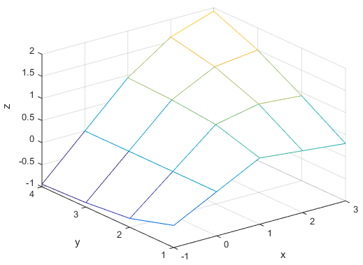
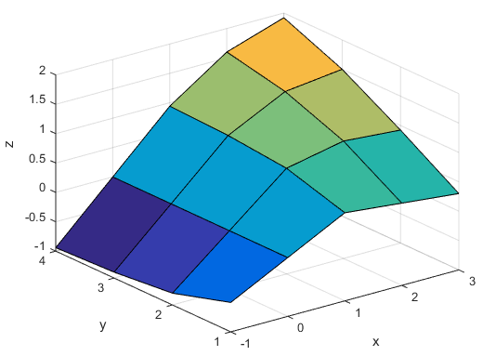
Plotting Mesh and Surface Graphs
Step 2: Calculate the values of z
Step 3: Plot the graph
Z = X .* Y.^2 ./ (X.^2 + Y.^2);
mesh(X, Y, Z)
surf(X, Y, Z)
m10_mesh_and_surf.m
figure(1);
mesh(X,Y,Z);
xlabel('x'); ylabel('y'); zlabel('z');

Slide 13
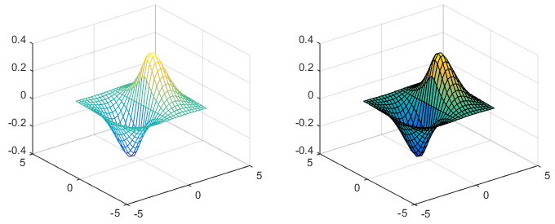
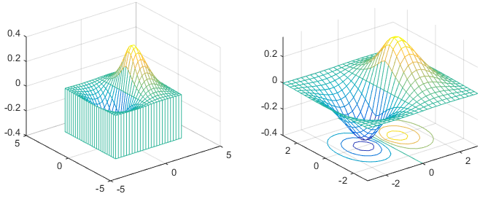
Various 3-D Graphs
x = -3:0.25:3;
[ X Y ] = meshgrid(x,x);
Z = 1.8.^(-1.5*sqrt(X.^2 + Y.^2)) ...
.* sin(X) .* cos(Y/2);
mesh(X,Y,Z);
surf(X,Y,Z);
mesh( X, Y, Z ); surf( X, Y, Z );
meshz( X, Y, Z ); meshc( X, Y, Z );
surfc( X, Y, Z ); surfl( X, Y, Z );
waterfall( X, Y, Z );
trisurf( delaunay(X,Y), X, Y, Z);
contour( X, Y, Z, 15);
contour3( X, Y, Z, 15);
meshz(X,Y,Z);
meshc(X,Y,Z);
m10_various_3d_graphs.m

Slide 14
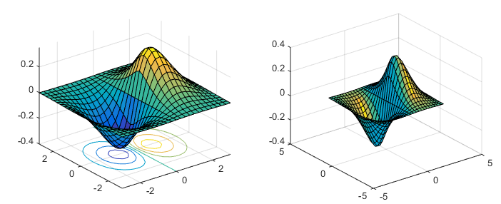
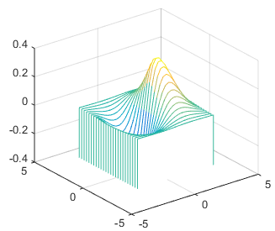
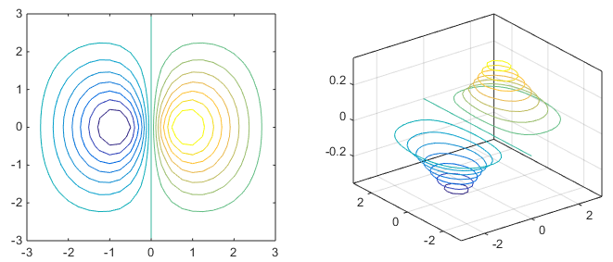
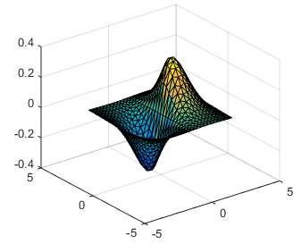
surfc(X,Y,Z);
surfl(X,Y,Z);
waterfall(X,Y,Z);
contour(X,Y,Z,15);
contour3(X,Y,Z,15);
trisurf(delaunay(X,Y),X,Y,Z);

Slide 15
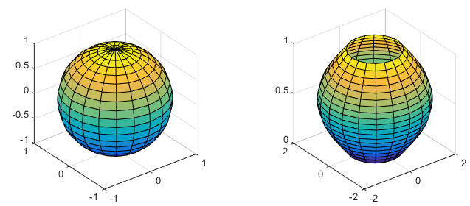
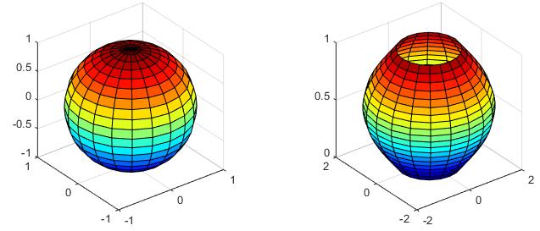
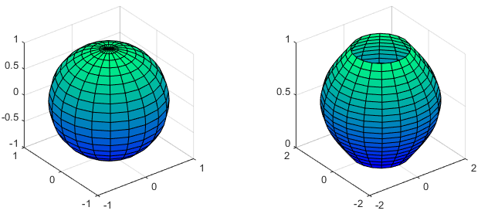
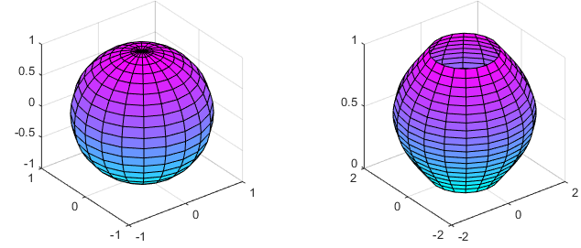
Sphere and Cylinder
colormap('parula');
colormap('winter');
[ X Y Z ] = sphere(20);
figure(1), surf(X,Y,Z), axis square;
colormap('jet');
t = linspace(0,pi,20);
r = 1 + sin(t);
[X Y Z] = cylinder(r);
figure(2), surf(X,Y,Z), axis square;
colormap('cool');
m10_sphere_cylinder.m

Slide 16
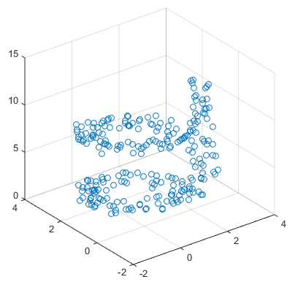
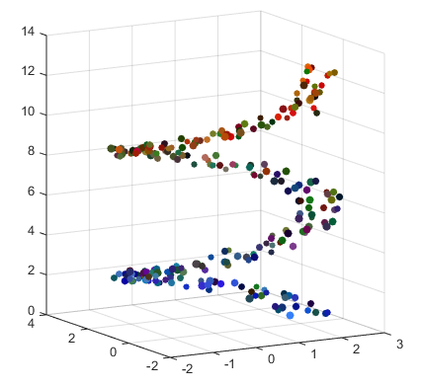
3D Scatter Plot
scatter( x, y, z, s, c )
m10_scatter3.m
N = 250;
z = linspace(0,4*pi,N)';
x = 2*cos(z) + rand(N,1);
y = 2*sin(z) + rand(N,1);
s = 20 + 20*rand(N,1); % scale
c = rand(N,3); % random color
g = [linspace(0.2,1,N); 0.5*ones(1,N); linspace(1, 0, N) ]'; % color weight
figure('Position', ...
[200 200 800 300], 'color', 'w');
subplot(1,2,1), scatter3( x, y, z );
subplot(1,2,2);
scatter3( x, y, z, s, c.*g, 'fill');
view(-30,10);

Slide 17
View Command
The view command controls the direction from which the plot is viewed.
view(az, el) or view([az, el])
z
y
[az el] = view;
view(3);
az = –37.5, el = 30
x

Slide 18
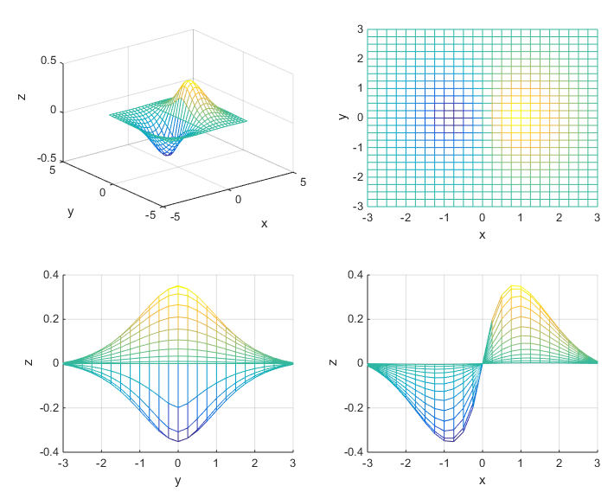
Different View Points
default or view(3)
view(0,90) or view(2)
m10_view.m
[X,Y]=meshgrid([-3:0.25:3],...
[-3:0.25:3]);
Z=1.8.^(-1.5*sqrt(X.^2+Y.^2))...
.*sin(X) .*cos(Y/2);
subplot(2,2,1), mesh(X,Y,Z); view(3);
subplot(2,2,2), mesh(X,Y,Z); view(2); % view( 0, 90 );
subplot(2,2,3), mesh(X,Y,Z); view(90, 0);
subplot(2,2,4), mesh(X,Y,Z); view( 0, 0);
view(90,0)
view(0,0)

Slide 19
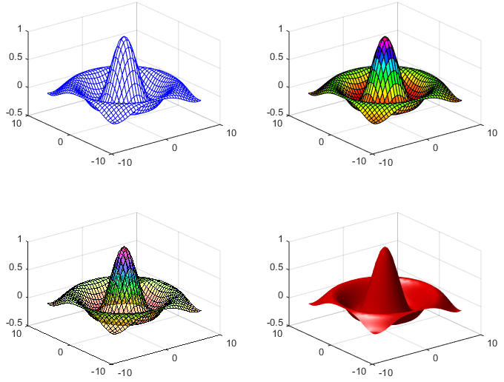
Colors
m10_surface_colors.m
[X,Y]=meshgrid(-8:.5:8);
R = sqrt(X.^2 + Y.^2) + eps;
Z = sin(R) ./ R;
subplot(2,2,1);
mesh(X,Y,Z, 'EdgeColor', 'b');
subplot(2,2,2);
surf(X,Y,Z); colormap('hsv');
subplot(2,2,3);
surf(X,Y,Z); alpha(0.4);
subplot(2,2,4), surf(X,Y,Z,'FaceColor', ...
'red', 'EdgeColor','none');
camlight left; lighting phong;

Slide 20
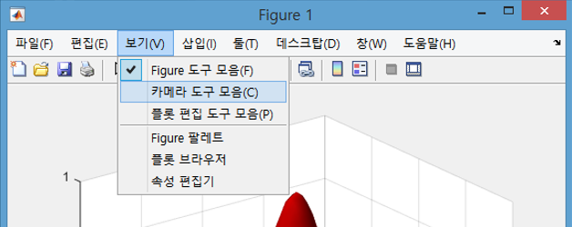
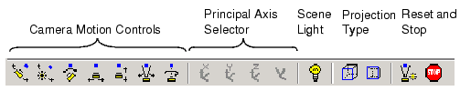
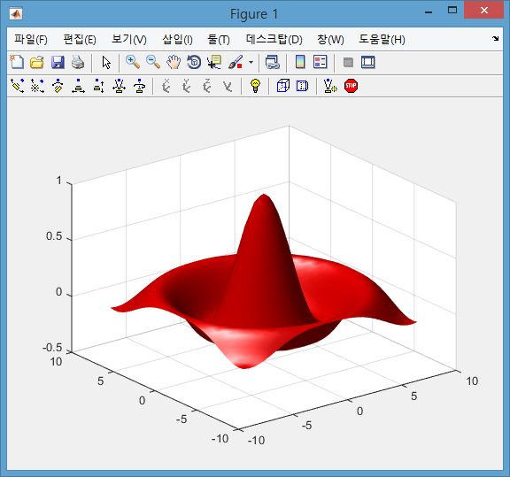
Camera Toolbar
Orbit Camera
Orbit Scene Light
Move Camera Forward and Backward
Zoom In and Out
Camera Roll
Toggle Lighting Effect
3D Projection
http://kr.mathworks.com/help/matlab/visualize/view-control-with-the-camera-toolbar.html

Slide 21
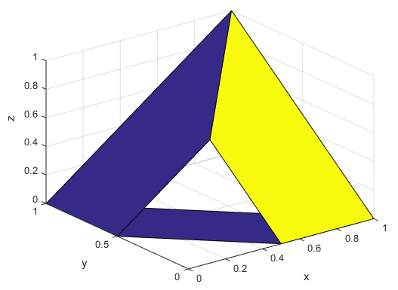
Patch
Low level surface plot function
Suitable for machine generated data
m10_patch_triangle.m
X = [0.0 0.5 0.5;
0.0 1.0 1.0;
0.5 1.0 0.0;
1.0 0.5 0.0];
Y = [1.0 0.0 0.0;
0.5 0.0 0.0;
0.5 1.0 1.0;
1.0 0.5 0.5];
Z = [0.0 0.0 0.0;
0.0 0.0 0.0;
0.5 1.0 0.0;
1.0 0.5 0.0];
C = [1 15 1;
1 15 1;
1 15 1;
1 15 1];
patch( X, Y, Z, C);
view(3); grid on;
xlabel('x'); ylabel('y'); zlabel('z');

Slide 22
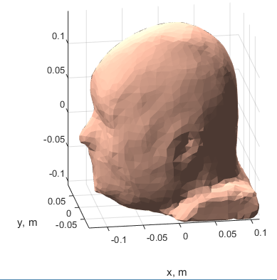
Human Head using Patch
Patch
m10_patch_man_head.m
load man_head X Y Z;
figure('Color', 'w');
patch(X, Y, Z, [1 0.75 0.65], ...
'EdgeColor', 'none', 'FaceAlpha', 1.0);
axis 'equal'; axis 'tight';
xlabel('x, m'); ylabel('y, m');
view(-9, 19); grid on;
light('Position',[1 3 2]);
light('Position',[-3 -1 3]);
material dull;
https://www.nevaelectromagnetics.com/page13/page10/SurfaceHumanBodyMeshes.html

Slide 23
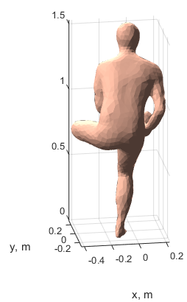
Human Body using Patch
Patch
m10_patch_leg_across.m
load man_leg_across X Y Z;
figure('Color', 'w');
patch(X, Y, Z, [1 0.75 0.65], ...
'EdgeColor', 'none', ...
'FaceAlpha', 1.0);
axis 'equal'; axis 'tight';
xlabel('x, m'); ylabel('y, m');
view(-9, 19); grid on;
light('Position',[1 3 2]);
light('Position',[-3 -1 3]);
material dull;
https://www.nevaelectromagnetics.com/SurfaceHumanBodyMeshes.html

Slide 24
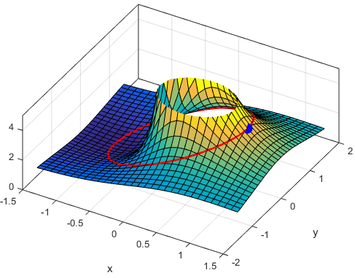
Application: Frequency Response of FIR Filter
Plot the magnitude surface of the following FIR filter over the z-plane as well as over the unit circle.

Slide 25
Script for z-Domain Response
m10_freq_response_fir_filter.m
[X Y] = meshgrid([-1.5:0.1:1.5],[-1.5:0.1:1.5]);
Z = X + j*Y;
Hz = 1 + 2*Z.^(-1) + Z.^(-2);
figure(1);
surf(X,Y,abs(Hz), min(abs(Hz),5)); zlim([0 5]);
view(30,60);
hold on;
t = 0:0.1:2*pi;
x = cos(t); y = sin(t); z = x + j*y;
hz = 1 + 2*z.^(-1) + z.^(-2);
plot3(x,y,abs(hz),'r-','LineWidth',2);
plot3(1,0,4,'yo', ...
'MarkerSize',10,'MarkerFaceColor','blue', ...
'MarkerEdgeColor','blue');
hold off;
xlabel('x'); ylabel('y');
box on;

Slide 26
Summary
Do you recognize the following commands?
plot3(x,y,z,'r-o')
box on
box off
hold on
sind(x)
sin(x)
[X Y]=meshgrid(x,y)
grid
view(30,65)
mesh(X,Y,Z)
surf(X,Y,Z,C)
alpha(0.4)
surf(X,Y,Z,'FaceColor','interp','EdgeColor','none')
colorbar
lighting phong
axis square
camlight left
colormap('Cool')
daspect([1 1 1])
view(3)
view(2)
camproj perspective
waterfall(X,Y,Z)
H(find(H>5))=5

